Slide 1
DISASTER RECOVERY WITH IBM VIRTUAL SERVERS.

Slide 2
DISASTER RECOVERY :
COMPLETING PREREQUISITES FOR DRaaS:
Before creating backups for the resources, we need to complete some prerequisite steps to ensure this service is able to access the environment and store backups.
And also select the plan for disaster recovery as a services:

Slide 3
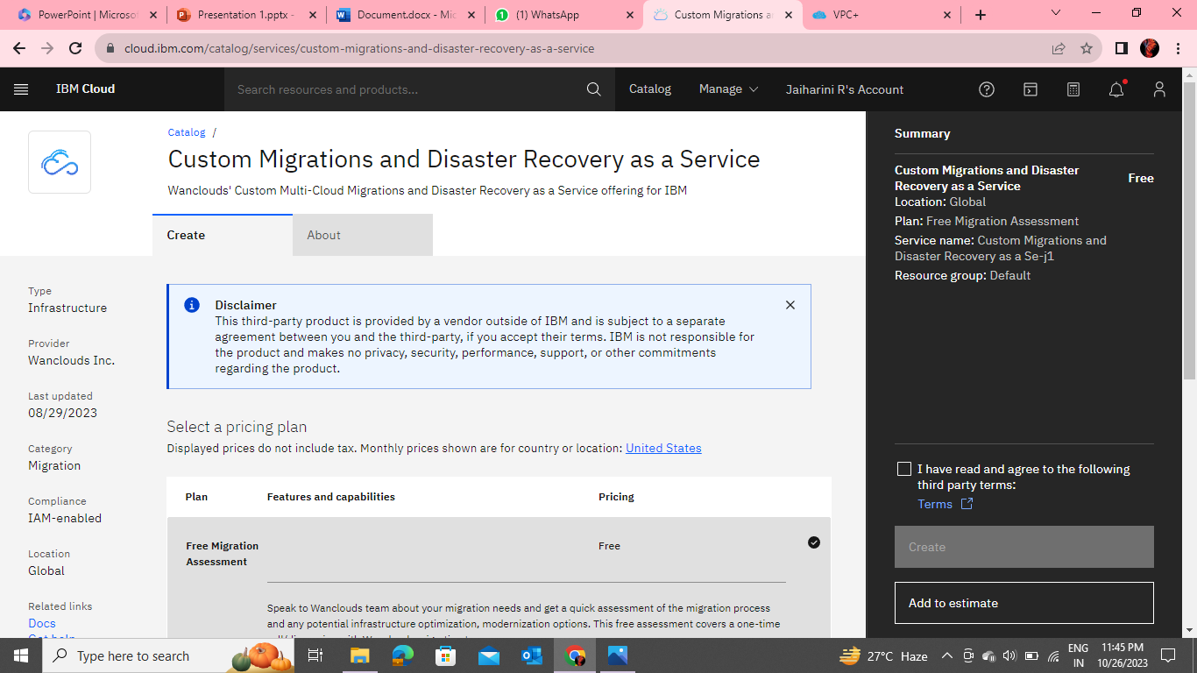
Custom Migrations and Disaster Recovery as a Service

Slide 4
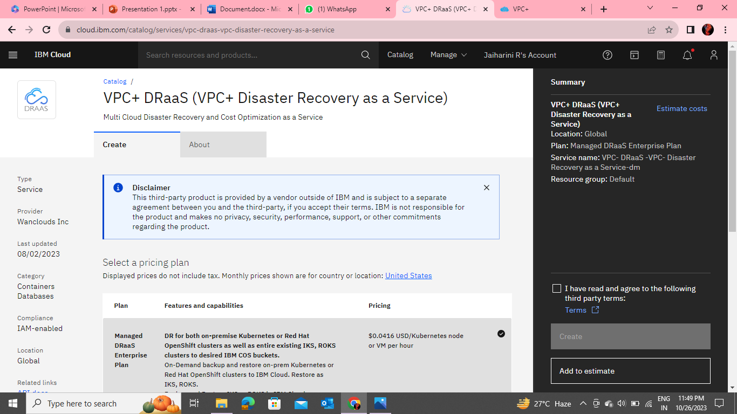
VPC+ DRaaS (VPC+ Disaster Recovery as a Service)

Slide 5
IBM Cloud Virtual Private Cloud and IKS & OpenShift Clusters
IBM Cloud Virtual Private Cloud (VPC)
Before discovering and backing up the IBM Virtual Private Cloud resources, we must have permissions for IBM Cloud classic and VPC.
An IBM Cloud API key (VPC API key).
For the IBM Cloud API key (VPC API key) must have “Reader, Writer” access. we can verify the level of access in IBM Cloud console by clicking Manage > Access (IAM) and selecting Authorizations.
An IBM Cloud Object Storage (COS) bucket and its Resource Instance ID (service credentials having manager role permissions). The COS bucket will be used to store the images and volumes during the migration process and its Resource Instance ID will allow VPC+ to access it.

Slide 6
IBM Cloud Virtual Private Cloud and IKS & OpenShift Clusters
IKS & OpenShift Clusters:
Before we discovering and backing up the IKS and OpenShift clusters, we must have the following permissions:
Ensure that there is the following IBM Cloud IAM access policies.
Administrator platform role for VPC Infrastructure.
Administrator platform role for IBM Cloud Kubernetes Service.
Writer or Manager service role for IBM Cloud Kubernetes Service.
Administrator platform role for Container Registry.
Writer or Manager service role for IBM Cloud Object Storage.
Make sure that the API key for the region and resource group that you plan to create the VPC Gen 2 cluster in is set up with the correct infrastructure permissions and then,Once we have completed all the prerequisites, see Creating our account on VPC+ DraaS.

Slide 7
VPC+ DRaaS
VPC+ by Wanclouds provides a comprehensive Disaster Recovery as a Service for our IBM Cloud Infrastructure and Resources.This DRaaS enables IBM Cloud customers to backup the entire virtual private cloud (VPC) resources including network, compute, storage as well as Kubernetes deployments, and be able to restore it across different regions in the IBM Cloud.

Slide 8
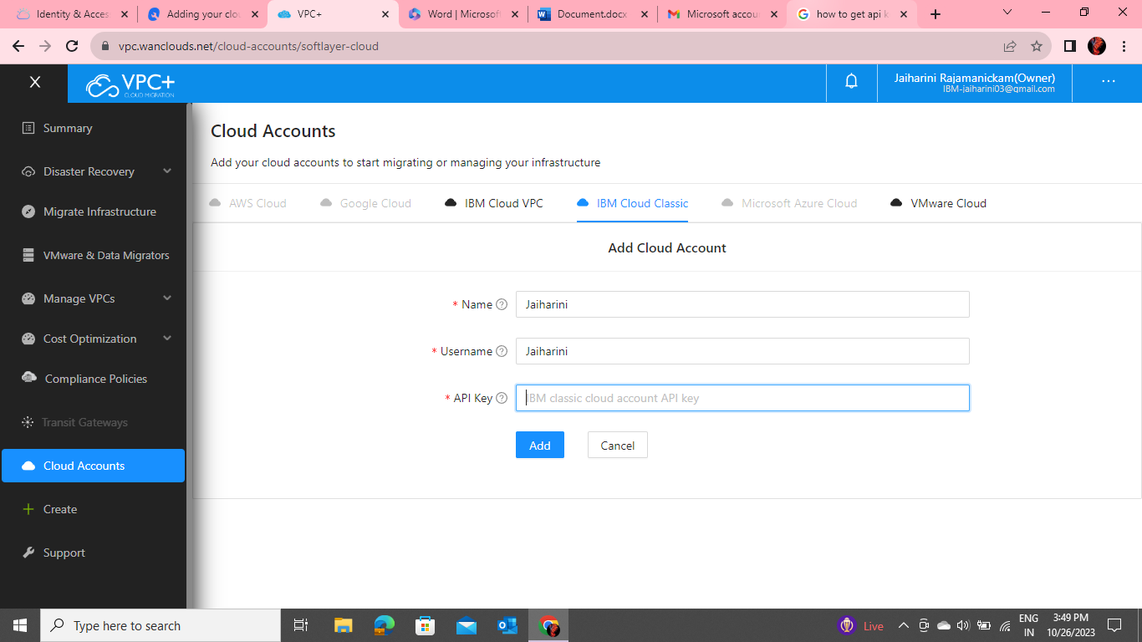
Adding your IBM Cloud Account to VPC+ DRaaS
IBM Cloud Classic Account: To add your IBM Cloud Classic Account, navigate to Cloud Accounts from the side menu.

Slide 9
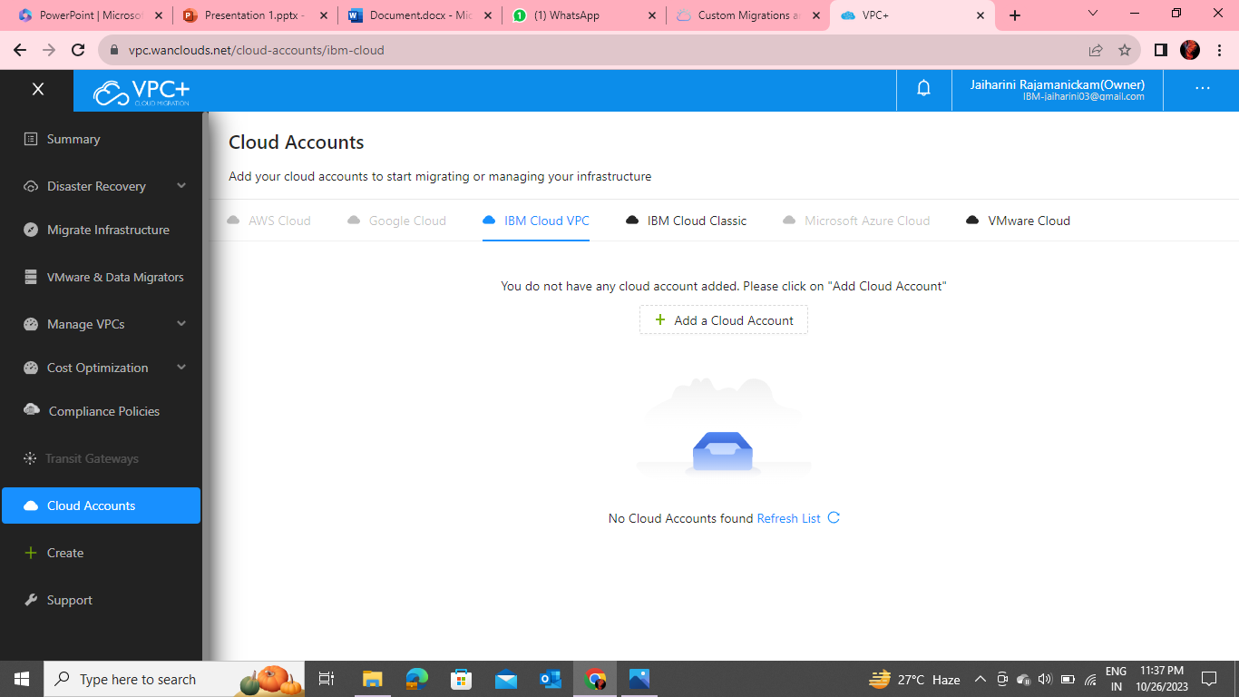
Give account Name and enter the username and API Key of your IBM Cloud infrastructure. This will be used to discover the resources of your current IBM Cloud Classic environment. IBM Cloud VPC Account Under the IBM Cloud VPC tab, click on Add Account to add your IBM Cloud VPC account.

Slide 10
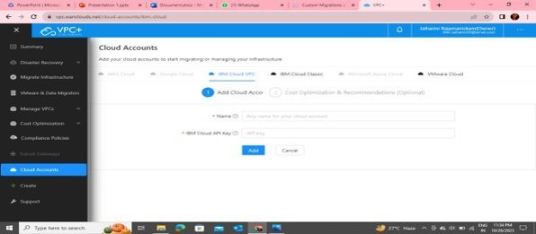
Give account Name and enter the IBM Cloud API Key.
And then,Once you have added your IBM Cloud account, you are all set to use Disaster Recovery as a Service for your IBM Cloud Infrastructure and Resources once your resources are discovered

Slide 11
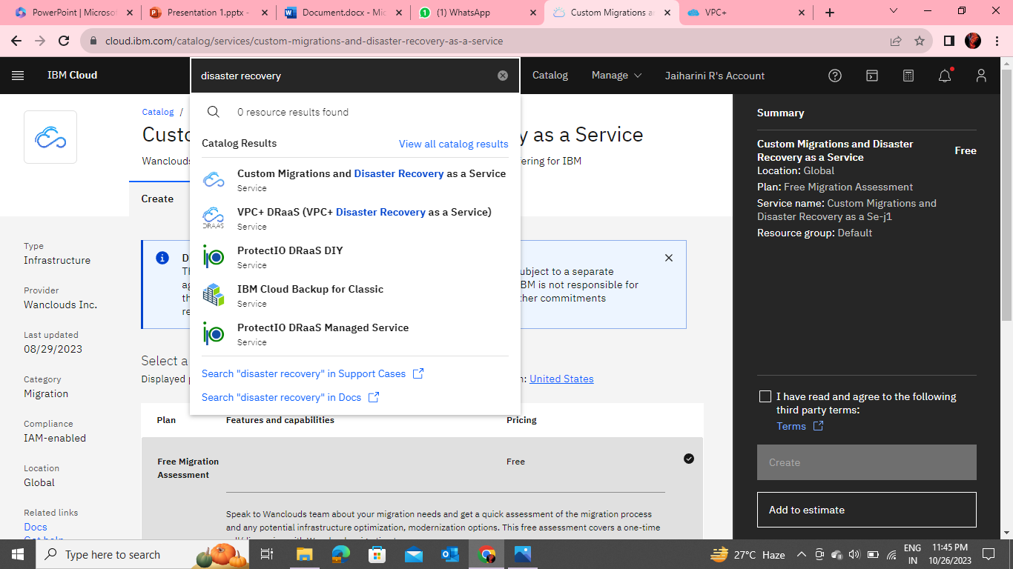
ACCESS THE VPC+ DRAAS TOOL
VPC+ DRaaS is a third-party service that can be accessed here. Or Go to IBM Cloud Catalog page and filter Wanclouds in Providers list on the left side of page. After filtering out the providers, then select VPC+ DRaaS (VPC+ Disaster Recovery As A Service).

Slide 12
Add your IBM Cloud Account to VPC+ DRaaS Tool
In order for VPC+ DRaaS to backup or restore your resources, you need to add your IBM Cloud account on VPC+.
Once if you have added your IBM Cloud account, you are all set to use the VPC+ Disaster Recovery as a Service for your IBM Cloud Infrastructure and Resources.
VPC+ by Wanclouds provides you with a comprehensive Disaster Recovery as a Service for your IBM Cloud Infrastructure and Resources.
Our DRaaS enables IBM Cloud customers to backup their entire virtual private cloud (VPC) resources including network, compute, storage as well as Kubernetes deployments, and be able to restore it across different regions in the IBM Cloud.

